Slide 1

Browser Compatibility
Saying goodbye to internet Explorer

Slide 2
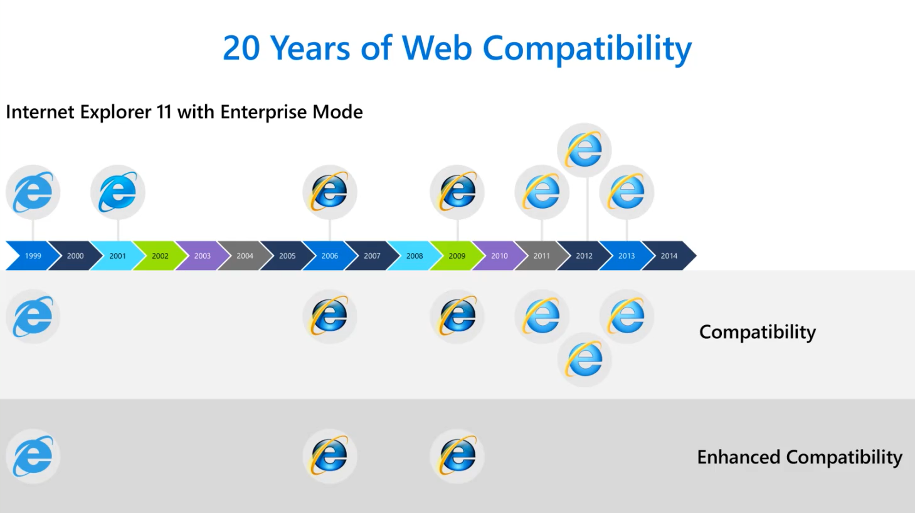

Slide 3
Edge – One Browser, All Sites

Slide 4

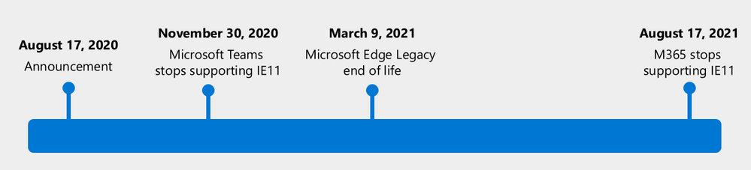
Reminder: Two important announcements
Microsoft 365 web apps and services won’t be supported on Internet Explorer 11 as of 8/17/2021.
Microsoft Teams ended support on 11/30/2020. Internet Explorer is still a component of Windows and follows the support lifecycle of the OS on which it’s installed. For details, see Lifecycle FAQ - Internet Explorer and Edge.
Microsoft Edge legacy desktop app won’t be supported or receive security updates on all versions of Windows 10 as of 3/9/2021.
Microsoft 365 apps say farewell to Internet Explorer 11 and Windows 10 sunsets Microsoft Edge Legacy - Microsoft Tech Community - 1591666
Notes:
First, I’d like to address some recent browser announcements by Microsoft.
On August 17th we announced that Microsoft 365 web apps and services won’t be supported on Internet Explorer 11 as of August 17, 2021. Teams was on an accelerated schedule and is not supported on IE11 as of November 30, 2020.
Many of our customers have been using IE 11 since 2013 when the online environment was much less sophisticated than the landscape today. Since then, open web standards and newer browsers—like the new Microsoft Edge—have enabled better, more innovative online experiences. We believe that you will be well served with this change through faster and more responsive web access to greater sets of features in everyday toolsets like Outlook, Teams, SharePoint, and more, and the new Microsoft Edge allows you to experience this.
We want to be clear that IE 11 isn’t going away and that your own legacy IE 11 apps and investments will continue to work. You’ve made business -critical investments in IE 11 legacy apps and we respect that those apps are still functioning; the new Microsoft Edge supports those through IE mode so you and your users can access them from a newer browser.
The second announcement was that the Microsoft Edge Legacy desktop app will no longer be supported and no longer receive security updates on all versions of Windows 10 on March 9, 2021. The new Microsoft Edge is Microsoft’s modern browser and we’re excited for you to experience it!
Note (in case a customer asks if IE mode can be used to circumvent this announcement): Using Internet Explorer mode in the new Microsoft Edge will not help to extend IE 11 access to Microsoft 365 apps and services beyond the dates listed above. Microsoft 365 apps and services will stop supporting IE 11 on the dates listed.

Slide 5
How do we pry Internet Explorer out of the business and end user’s machines?
How do we move from Internet Explorer to Edge?
Internet Explorer Mode!
How do we convince them it will be okay?

Slide 6
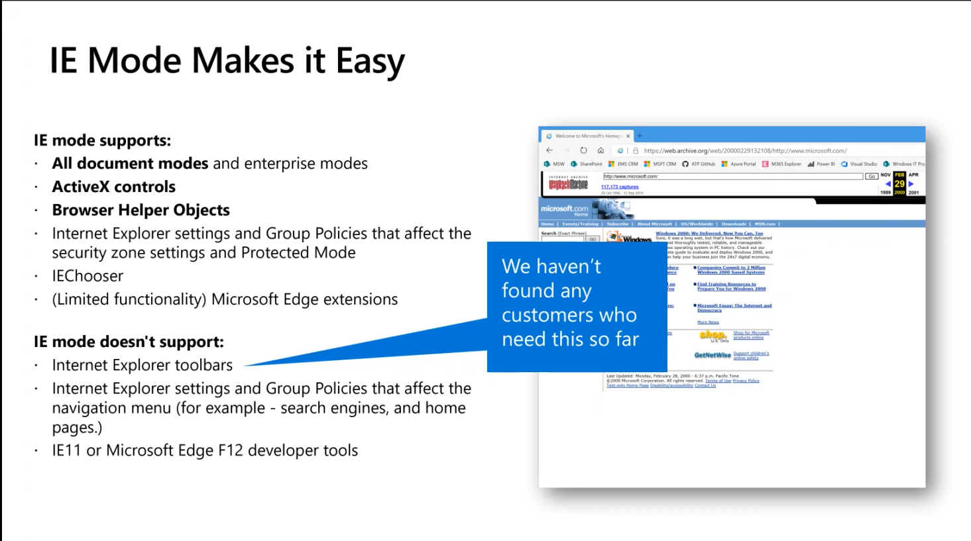

Slide 7

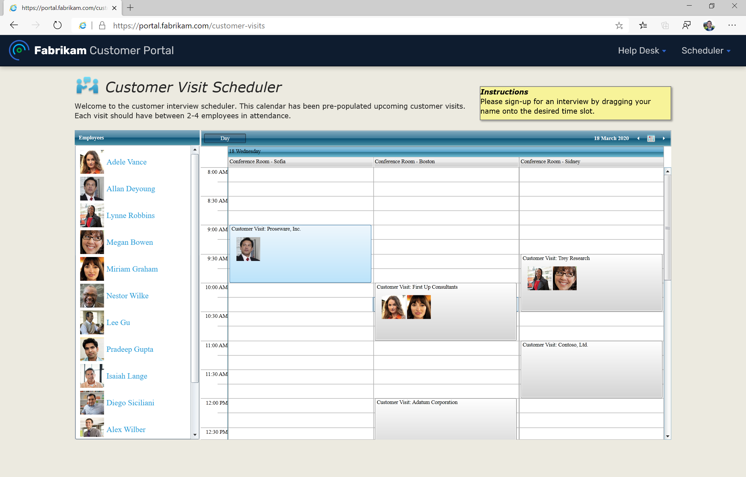

Internet Explorer mode
The new Microsoft Edge supports Internet Explorer mode
Open legacy and modern sites in one browser
Supports ActiveX controls, Doc Modes, Polyfills, etc.
Supported on all platforms where IE11 is supported.
IE mode is an enterprise-only feature,
fully in the admin’s control
Can use the existing Enterprise Mode Site List to control which sites get IE mode and which get the modern rendering engine.
Notes:
This feature takes advantage of the Enterprise Mode site tool/list that we shipped in IE11. If you’ve already identified what sites need to load in IE11 for whatever reason, then that site list will work in IE mode in the new Edge.
If a site/app works in stand-alone IE11, it will work in IE mode. If it doesn’t, let us know and the App Assure program comes into play on this promise as well.

Slide 8
Edge Settings Urls
My Favorites
edge://about/
edge://compat/iediagnostic
edge://policy
edge://sync-internals/

Slide 9
How to Configure IE Mode
Enterprise Site List xml
Create or use existing Enterprise Site List
Best practice is to use the 2.0 schema
Accessible Location
Place .xml file on file share or https://
Policy
Configure Group Policy or Intune Policy
Configure the Enterprise Site List (Edge ADMX)
Configure Internet Explorer integration

Slide 10
Demo

Slide 11
Enterprise Site List

Slide 12
Creating the Enterprise Site List
Not new, it’s been around for years
Configures the compatibility mode for a specific website
Import a 1.0 schema .xml file into 2.0 to easily convert it
Resources
Document Modes
IE Document mode flow chart
Review neutral sites for Internet Explorer mode using the Enterprise Mode Site List Manager
https://docs.microsoft.com/en-us/internet-explorer/ie11-deploy-guide/use-the-enterprise-mode-site-list-manager
Notes:
Neutral sites are used for modern and legacy authentication servers used for modern and legacy sites

Slide 13
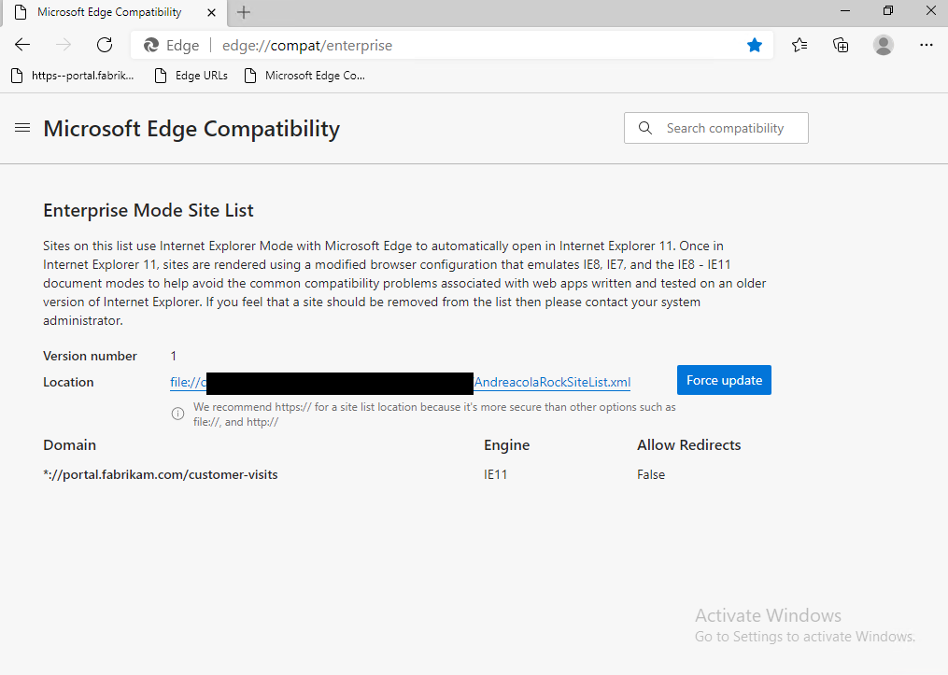
Troubleshooting IE mode Enterprise Site List
edge://compat/enterprise

Slide 14
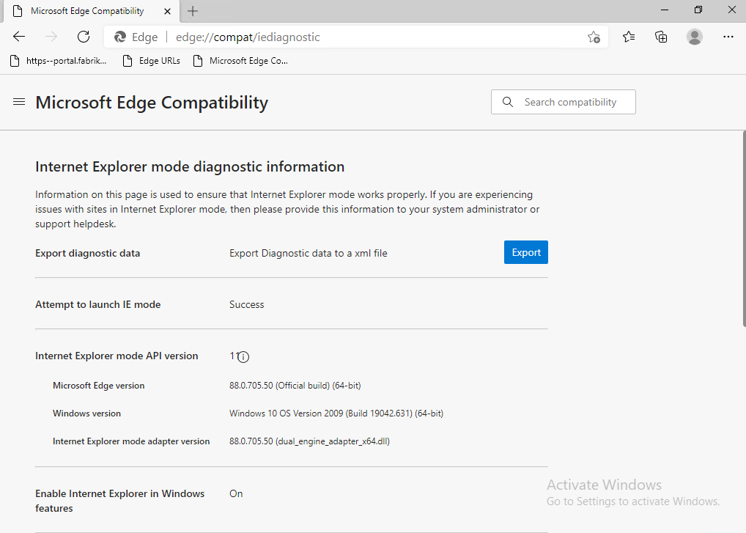
Troubleshooting IE mode Diagnostics
edge://compat/iediagnostic

Slide 15
Demo
Notes:
Show Url and Enterprise Site List Manager

Slide 16
Identify Sites Requiring Internet Explorer

Slide 17


How can identify legacy sites in my organization?“
Enterprise Site Discovery (optional)
https://docs.microsoft.com/en-us/deployedge/edge-ie-mode-site-discovery
Does not tell you what sites are compatible
If not targeted correctly can be a large report
Dependencies on ConfigMgr and SQL for easy viewing
Recommendation is to allow it to run for no more than 30 days
Notes:
Enterprise Site Discovery
Discover which sites are using legacy document modes. Unless these sites are detecting modern browsers and providing different HTML, they probably need to use IE mode.
Discover which sites are using ActiveX controls. Microsoft Edge doesn't support ActiveX controls. Unless these sites are detecting modern browsers and providing different HTML, they probably need to use IE mode

Slide 18
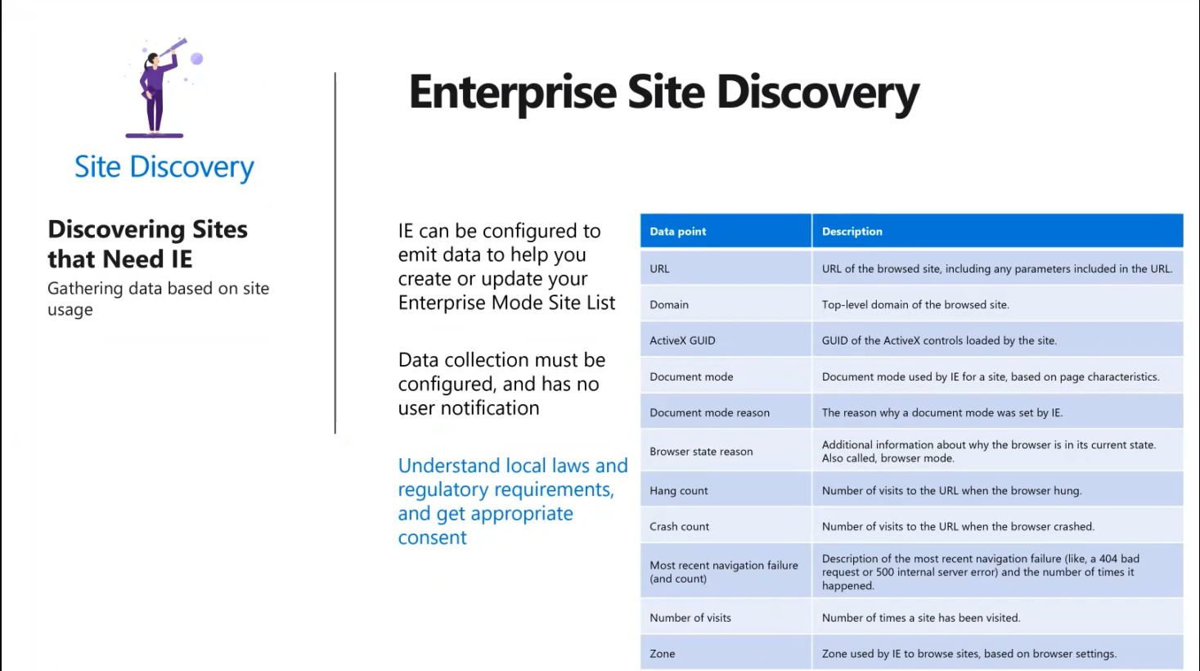

Slide 19
Setup – Configuration Manager
Download
Enterprise Site Discovery Setup and Configuration Package
Microsoft Report Builder
Package IETelemetrySetUp-Win8.ps1 in MEMCM – Will require a reboot
Set GPO - Computer Configuration > Administrative Templates > Windows Components > Internet Explorer
Turn on Site discovery WMI output
Limit Site Discovery to 30 days or less – Don’t forget to disable
Extend MEMCM Hardware Inventory
Import Site Discovery Reports

Slide 20
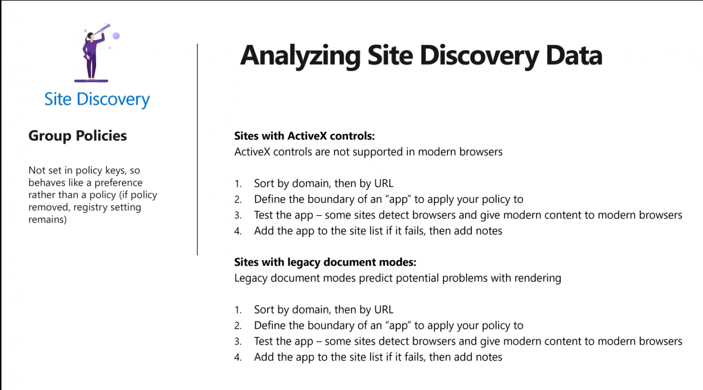

Slide 21
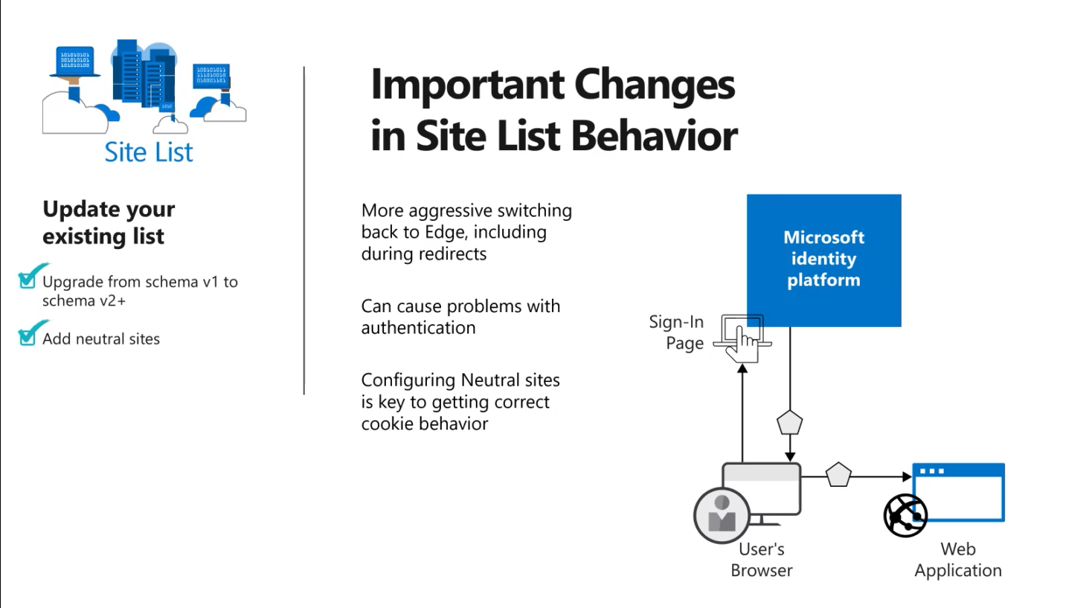
Notes:
Neutral Sites

Slide 22
Tips and Tricks
PowerShell to see data being collected on client
Get-WMIObject -namespace root/cimv2/IETelemetry IEURLInfo
Get-WMIObject -namespace root/cimv2/IETelemetry IEURLInfo | Where{$_.DocMode -lt 11}
Get-WMIObject -namespace root/cimv2/IETelemetry IEURLInfo | Select-Object –Property DocMode,DocModeReason,ActiveXGUID,URL | Where{$_.DocMode -lt 11}
Future of Enterprise Site List Manager
Built into the browser starting in Edge 89 (currently Dev channel)
Enterprise Site List Manager in Microsoft Edge | Microsoft Docs

Slide 23
Demo
Notes:
Demo Admin Center Edge setup wizard

Slide 24




Get support at no additional cost
App Assure
If your web apps or sites work in Internet Explorer 11, on supported versions of Google Chrome, or in any version of Microsoft Edge, they’ll also work with the new Microsoft Edge. If you encounter compatibility issues, we provide remediation guidance at no additional cost.
Microsoft
FastTrack
For customers who have deployed over 150 seats of Windows 10 Enterprise, The FastTrack program has been extended to support the deployment of the new Microsoft Edge at no additional cost.
Microsoft
Unified Support
Beta and Stable channels are supported through Unified Support. If you already have a Unified Support contract, Microsoft Edge is supported at no additional cost.
Notes:
We also know that transitioning to a new browser, particularly during this time, may not be easy. With the new Microsoft Edge, we provide support mechanisms to address this and believe that adding support for Microsoft Edge shouldn’t mean adding additional cost.
We’ve already talked about App Assure and, as you know, FastTrack offers deployment guidance. But if you have an existing Unified Support plan, Microsoft Edge is also supported and at no additional cost.
With Microsoft Edge, you can get in touch with real people who can help make the transition as smooth as possible.

